Slide 1

lightform.org.uk
Hot-rolling of dual phase titanium: initial steps towards a coupled crystal-plasticity/phase-field model
Adam Plowman, João Quinta da Fonseca, Pratheek Shanthraj
TIFUN Progress Meeting, 09/09/2021

Slide 2

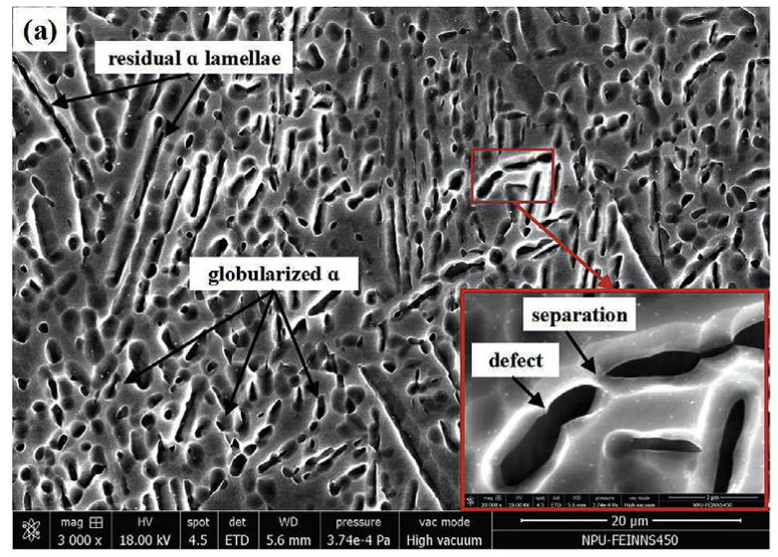
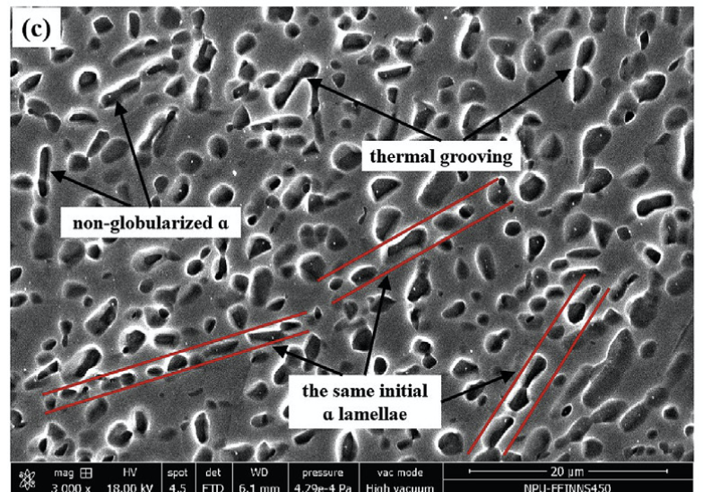
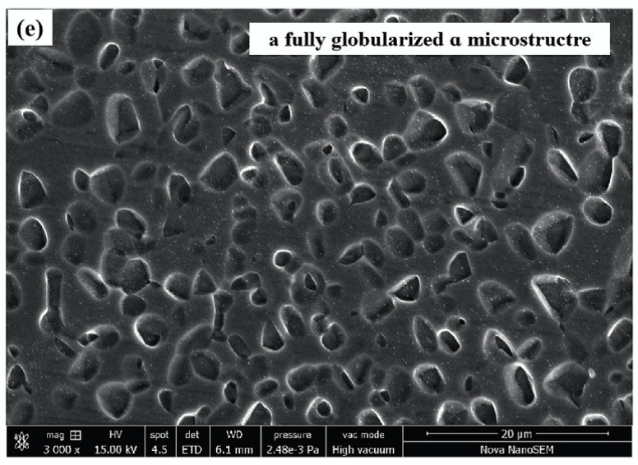

Project aims
Aims
Investigate microstructural evolution of dual-phase titanium under hot rolling
Develop a coupled crystal-plasticity (CP) / phase-field (PF) model within the DAMASK [1] package
Use the model to track the kinetics of microstructural development during hot rolling
Use insights from the model to understand our experimental observations (e.g. Bernadeta’s results)
[1] Roters, F., M. Diehl, P. Shanthraj, P. Eisenlohr, C. Reuber, S. L. Wong, T. Maiti, et al. ‘DAMASK – The Düsseldorf Advanced Material Simulation Kit for Modeling Multi-Physics Crystal Plasticity, Thermal, and Damage Phenomena from the Single Crystal up to the Component Scale’. Computational Materials Science 158 (15 February 2019): 420–78. https://doi.org/10.1016/j.commatsci.2018.04.030
https://damask3.mpie.de/

Slide 3
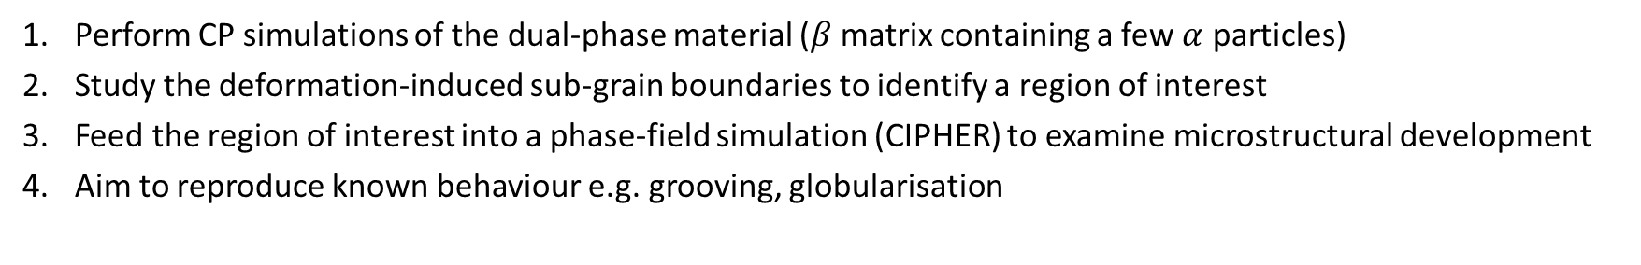
Project aims
Part 1: static microstructural development (post-deformation) – ongoing
Perform CP simulations of the dual-phase material ($β$matrix containing a few $α$ particles)
Study the deformation-induced sub-grain boundaries to identify a region of interest
Feed the region of interest into a phase-field simulation (CIPHER) to examine microstructural development
Aim to reproduce known behaviour e.g. grooving, globularisation
Part 2: dynamic microstructural development (during deformation) – starting soon
Familiarise myself with the DAMASK code base
Assess usability of pre-existing phase-field branch in DAMASK source
(Probably) re-write phase-field functionality in DAMASK
Simulate deformation in the coupled model to obtain a more accurate material response
Notes:
Part 1 CP sims: Varying key parameters: hard vs soft loading direction, surface roughness of particles, volume fraction of particles

Slide 4
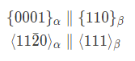
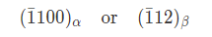
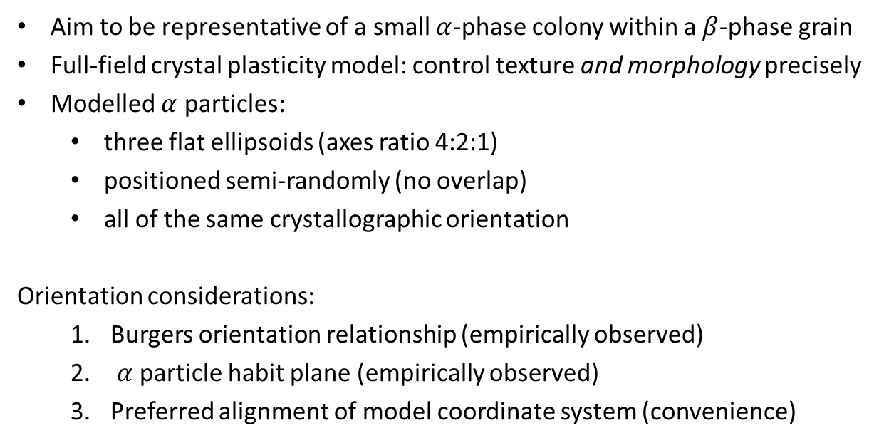
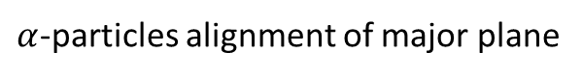
Dual-phase volume element generation
Model geometry considerations
Aim to be representative of a small $α$-phase colony within a $β$-phase grain
Full-field crystal plasticity model: control texture and morphology precisely
Modelled $α$ particles:
three flat ellipsoids (axes ratio 4:2:1)
positioned semi-randomly (no overlap)
all of the same crystallographic orientation
Orientation considerations:
Burgers orientation relationship (empirically observed)
$α$ particle habit plane (empirically observed)
Preferred alignment of model coordinate system (convenience)
Burgers orientation relationship
$α$-particles alignment of major plane
Preferred model alignment

Slide 5
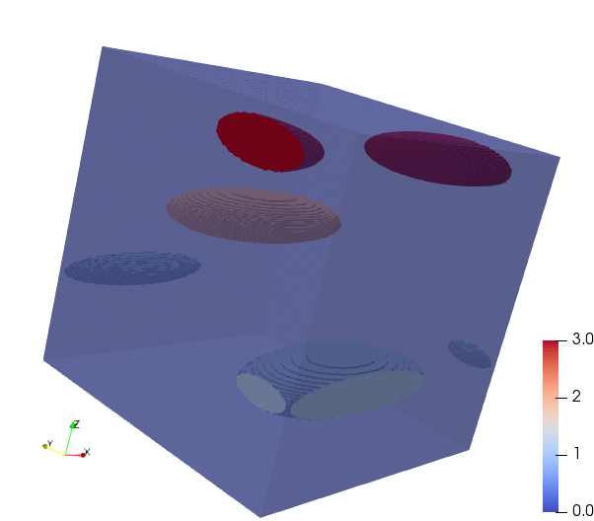
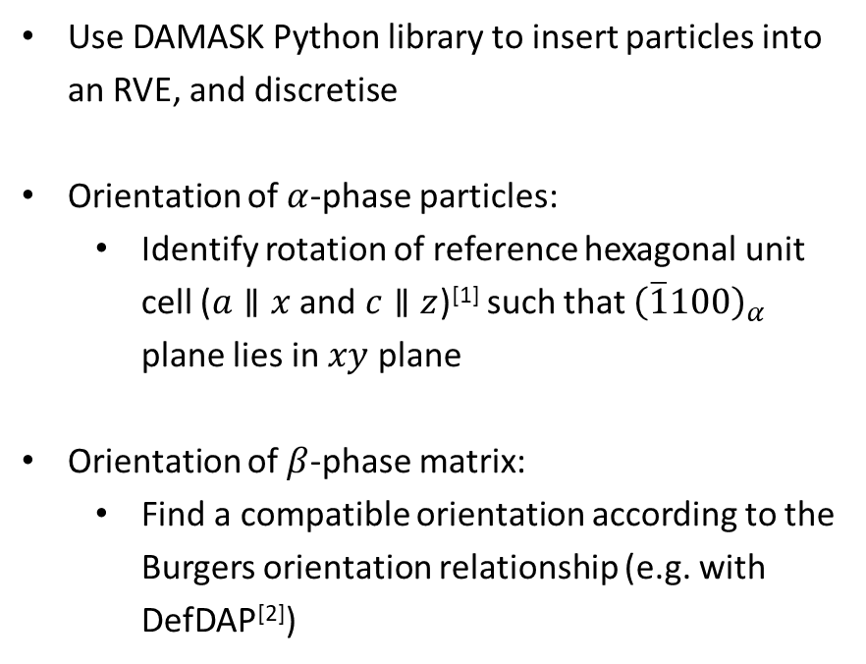
Dual-phase volume element generation
Volume element generation
Use DAMASK Python library to insert particles into an RVE, and discretise
Orientation of $α$-phase particles:
Identify rotation of reference hexagonal unit cell ($a∥x$ and $c∥z$)^{[1]} such that ${\left(\overline{1}100\right)}_{α}$ plane lies in $xy$ plane
Orientation of $β$-phase matrix:
Find a compatible orientation according to the Burgers orientation relationship (e.g. with DefDAP^{[2]})
Dual-phase volume element (periodic) for full-field CP simulation
[1] Hexagonal unit cell alignment used by DAMASK
[2] Atkinson, Michael D et al. (2021) https://doi.org/10.5281/zenodo.5236760

Slide 6
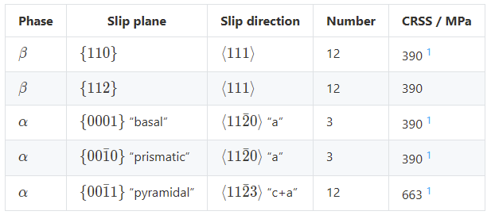
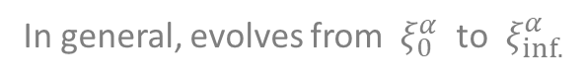
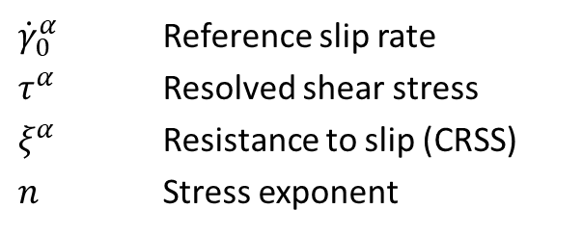
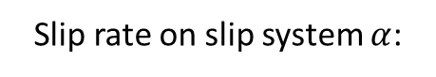

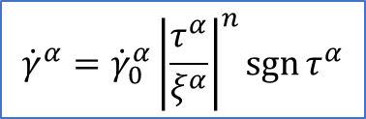
Crystal plasticity model
Material model
Simple phenomenological power law:
${\dot{γ}}_{0}^{α}$ Reference slip rate
$τ^{α}$ Resolved shear stress
$ξ^{α}$ Resistance to slip (CRSS)
$n$ Stress exponent
$${\dot{γ}}^{α}={\dot{γ}}_{0}^{α}{\left|\frac{τ^{α}}{ξ^{α}}\right|}^{n}\operatorname{sgn}{τ^{α}}$$
Slip rate on slip system $α$:
In general, evolves from $ξ_{0}^{α}$ to $ξ_{inf.}^{α}$
Material parameters
Note: no hardening for now ($ξ_{0}^{α}=ξ_{inf.}^{α}$)
[1] Kasemer et al. (2017), “The Influence of Mechanical Constraints Introduced by β Annealed Microstructures on the Yield Strength and Ductility of Ti-6Al-4V”
Notes:
We may revise CRSS parameters in future.

Slide 7
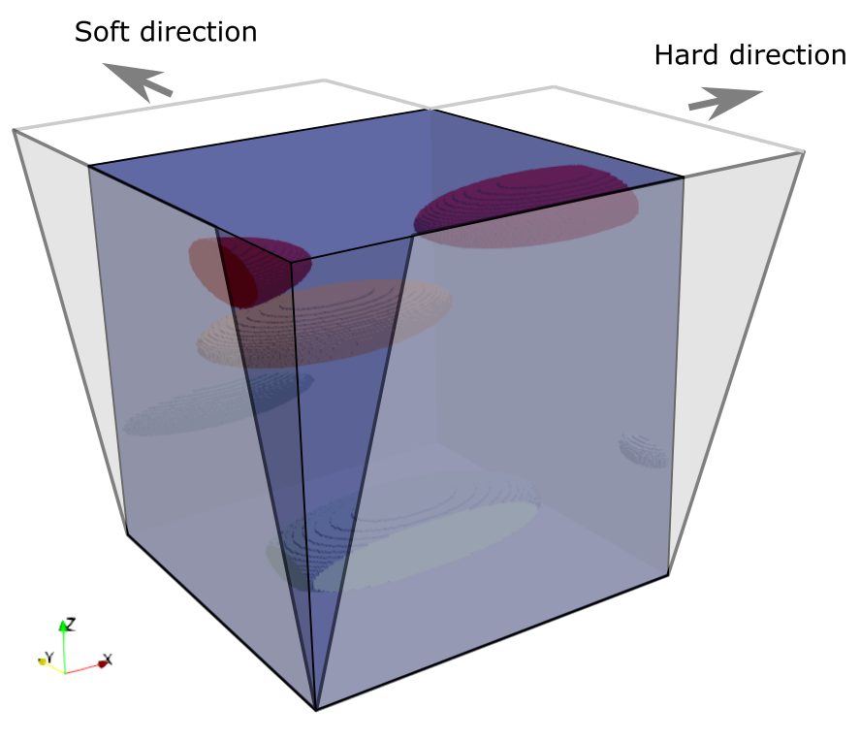
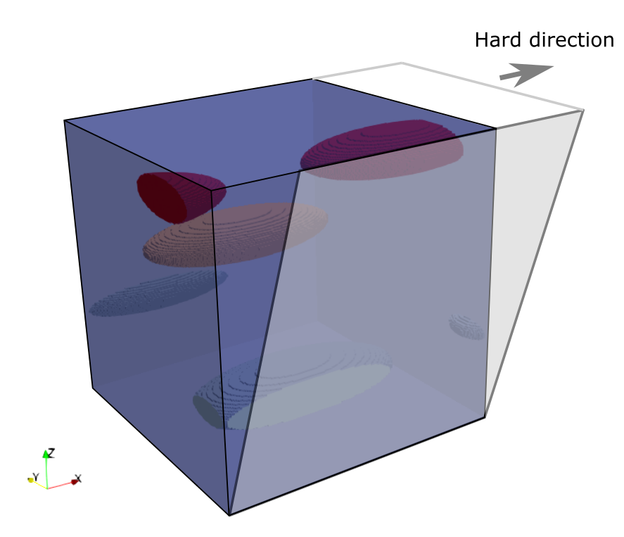
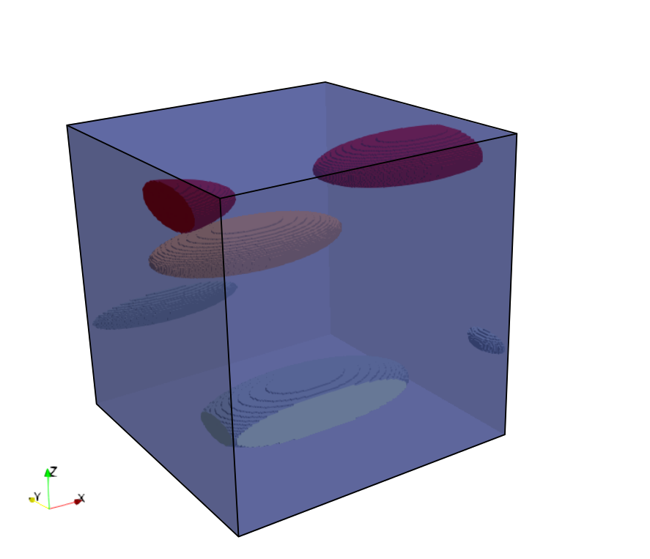
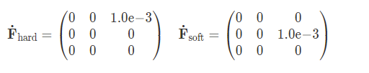
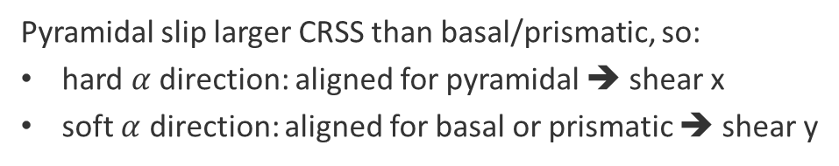
Loading
Initially comparing $α$-phase “soft” and “hard” loading directions
Loading in DAMASK can be specified with strain- and/or stress-like tensors (component-wise exclusively)
Rolling is essentially plane-strain compression; this would require “mixed” boundary conditions
Instead, we have initially opted for simple shear loading (numerically simpler):
Pyramidal slip larger CRSS than basal/prismatic, so:
hard $α$ direction: aligned for pyramidal ➔ shear x
soft $α$ direction: aligned for basal or prismatic ➔ shear y

Slide 8
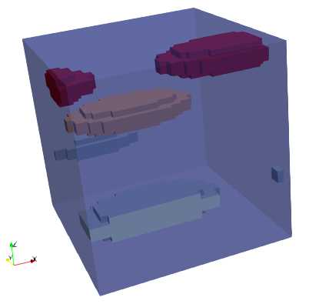
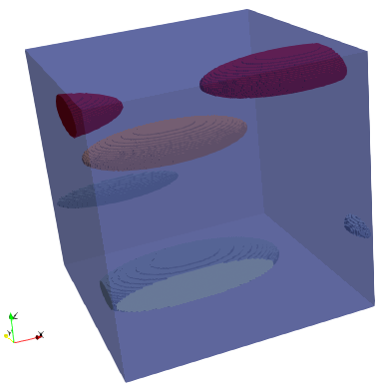
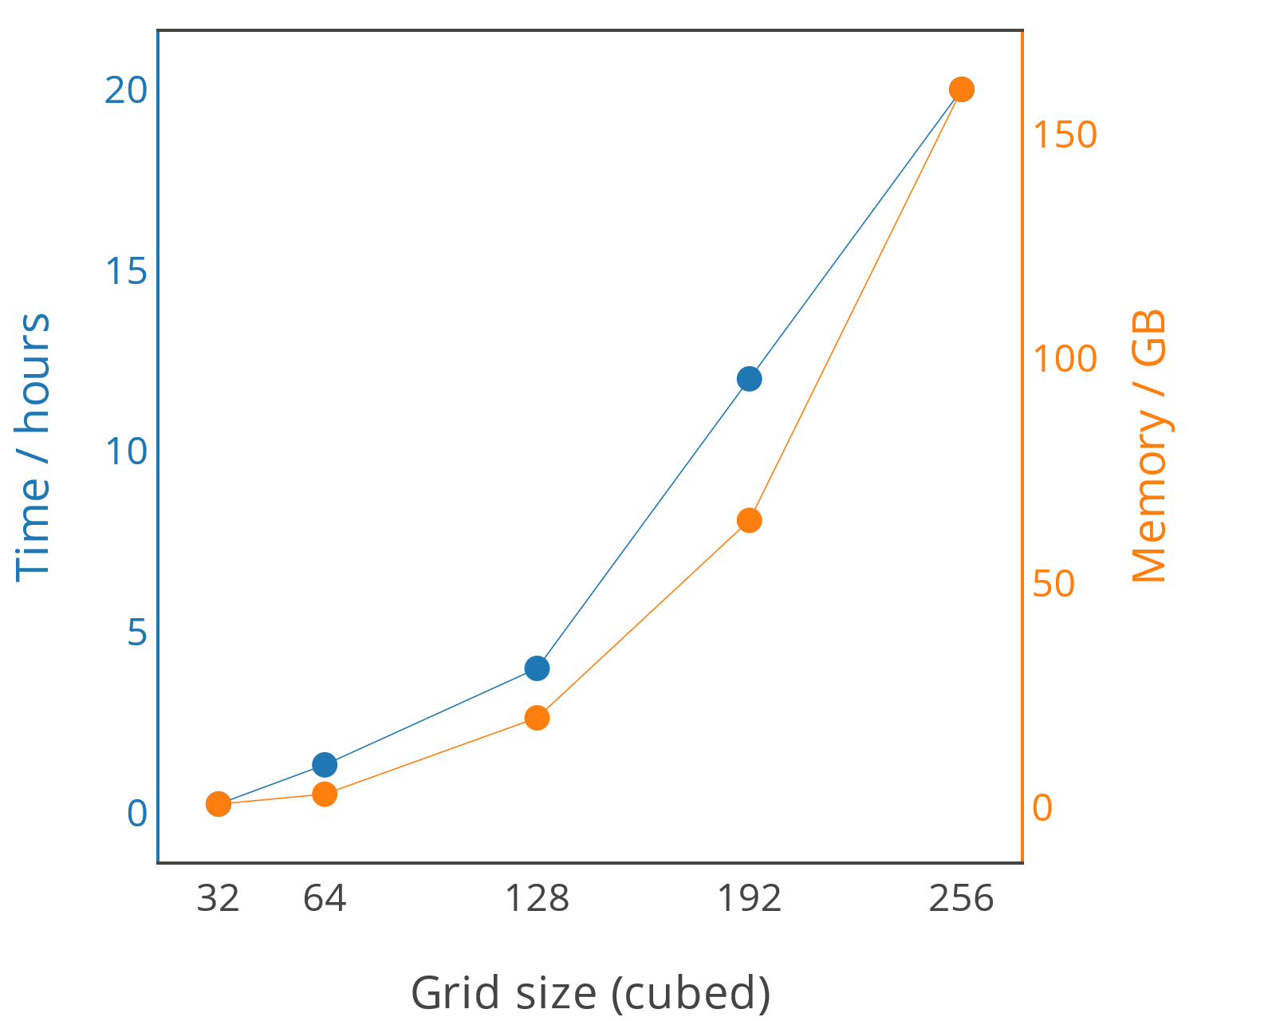


Model resolution
Investigating resource requirements
8 cores
16 cores
32 cores
32 $×$ 32 $×$ 32
192 $×$ 192 $×$ 192
Need to adequately resolve curved morphology
Want smooth variations in e.g. stress/strain fields
Later need investigations of surface roughness to be valid

Slide 9
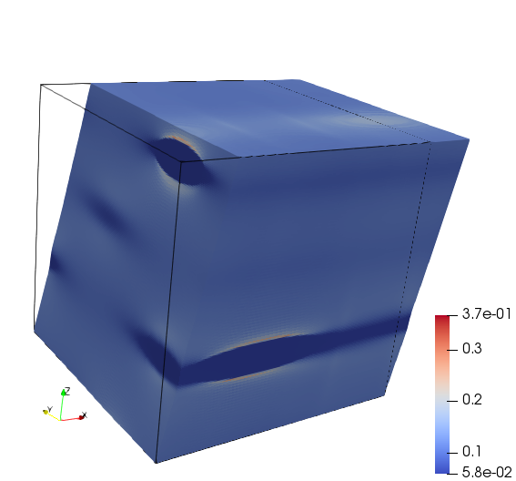
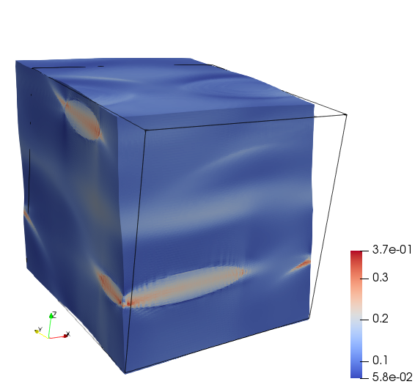

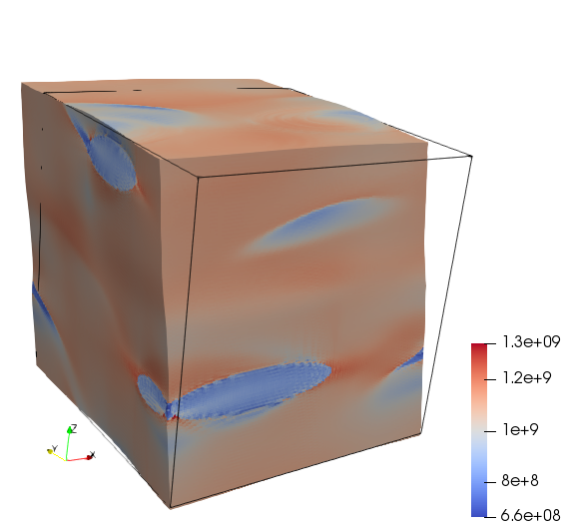
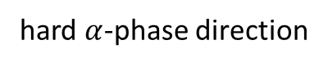
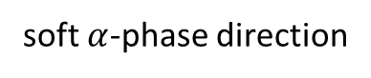
Preliminary results
CP simulations: stress/strain fields
hard $α$-phase direction
soft $α$-phase direction
Von Mises equivalent plastic strain
(range: 0.058 to 0.370)
Von Mises equivalent stress
(range: 0.7 to 1.3 GPa)

Slide 10
Preliminary results
Orientation clustering: cost-function approach
Aim to cluster voxels of the RVE into deformation-induced sub-grains
Initial approach:
Define a cost function that:
Chooses a set of trial centroids and perform discrete Voronoi tessellation
Calculates a quaternion “average” for each Voronoi region [1]
Calculates a quaternion “variance” for each Voronoi region (using misorientation as the distance metric)
Sum variances of all regions
Iterate on centroid positions to minimise variance using a gradient-less optimisation method such as Nelder-Mead
Problems:
Voronoi tessellation is too time- and/or memory-intensive to use within a tractable optimisation
We want to specify a threshold misorientation (i.e. we do not know how many clusters there should be)
[1] Markley, F. Landis, et al. ‘Averaging Quaternions’. Journal of Guidance, Control, and Dynamics 30, no. 4 (July 2007): 1193–97. https://doi.org/10.2514/1.28949.

Slide 11

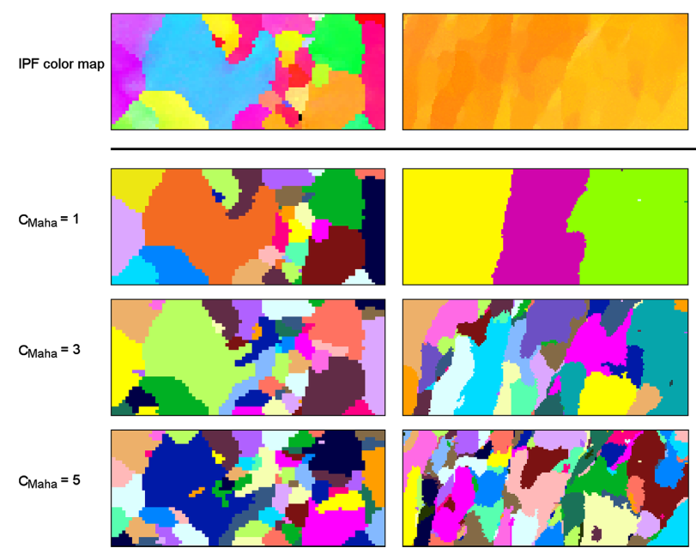

Preliminary results
Orientation clustering: EBSD analysis software
Grain segmentation is routinely performed when analysing (3D) EBSD data. Can we use existing methods?
MTEX
An open-source Matlab toolbox
Provides two methods for grain segmentation: Markovian and Fast Multiscale Clustering [1]
Current progress: difficulty loading 3D data (could be my fault, GitHub issue created [2]), will revisit
Easier to cluster
Harder to cluster
Dream.3D
An open-source pipeline-based microstructural analysis toolkit
Provides a “grain segmentation” filter
Current progress: still experimenting, problem is perhaps smoothly-varying misorientation
[1] McMahon, Cullen, Brian Soe, Andrew Loeb, Ayyappa Vemulkar, Michael Ferry, and Lori Bassman. ‘Boundary Identification in EBSD Data with a Generalization of Fast Multiscale Clustering’. Ultramicroscopy 133 (1 October 2013): 16–25. https://doi.org/10.1016/j.ultramic.2013.04.009
[2] https://github.com/mtex-toolbox/mtex/issues/1170
Notes:
These software use a misorientation threshold.

Slide 12
Reproducibility
Integrating this work into a MatFlow workflow
We have developed a computational workflow management tool for materials science, MatFlow [1]
Aims:
Making reproducibility and transparency require less effort (can cite a single HDF5 file in your paper)
Connecting disparate software via extensions (proprietary and open-source)
Making comparisons easier (the same scientific objective can often be achieved in distinct ways)
We are developing a MatFlow workflow in parallel as we progress with this project.
This will enable straightforward replication and tweaking
[1] Adam Plowman et al. (2021). LightForm-group/matflow: v0.2.22 (v0.2.22). Zenodo. https://doi.org/10.5281/zenodo.5201666

Slide 13
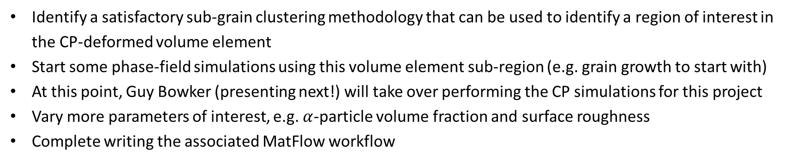
Next steps
Part 1 (static microstructural development)
Identify a satisfactory sub-grain clustering methodology that can be used to identify a region of interest in the CP-deformed volume element
Start some phase-field simulations using this volume element sub-region (e.g. grain growth to start with)
At this point, Guy Bowker (presenting next!) will take over performing the CP simulations for this project
Vary more parameters of interest, e.g. $α$-particle volume fraction and surface roughness
Complete writing the associated MatFlow workflow
Part 2 (dynamic microstructural development – coupled model)
Begin working with and understanding the DAMASK code base

